Slide 1
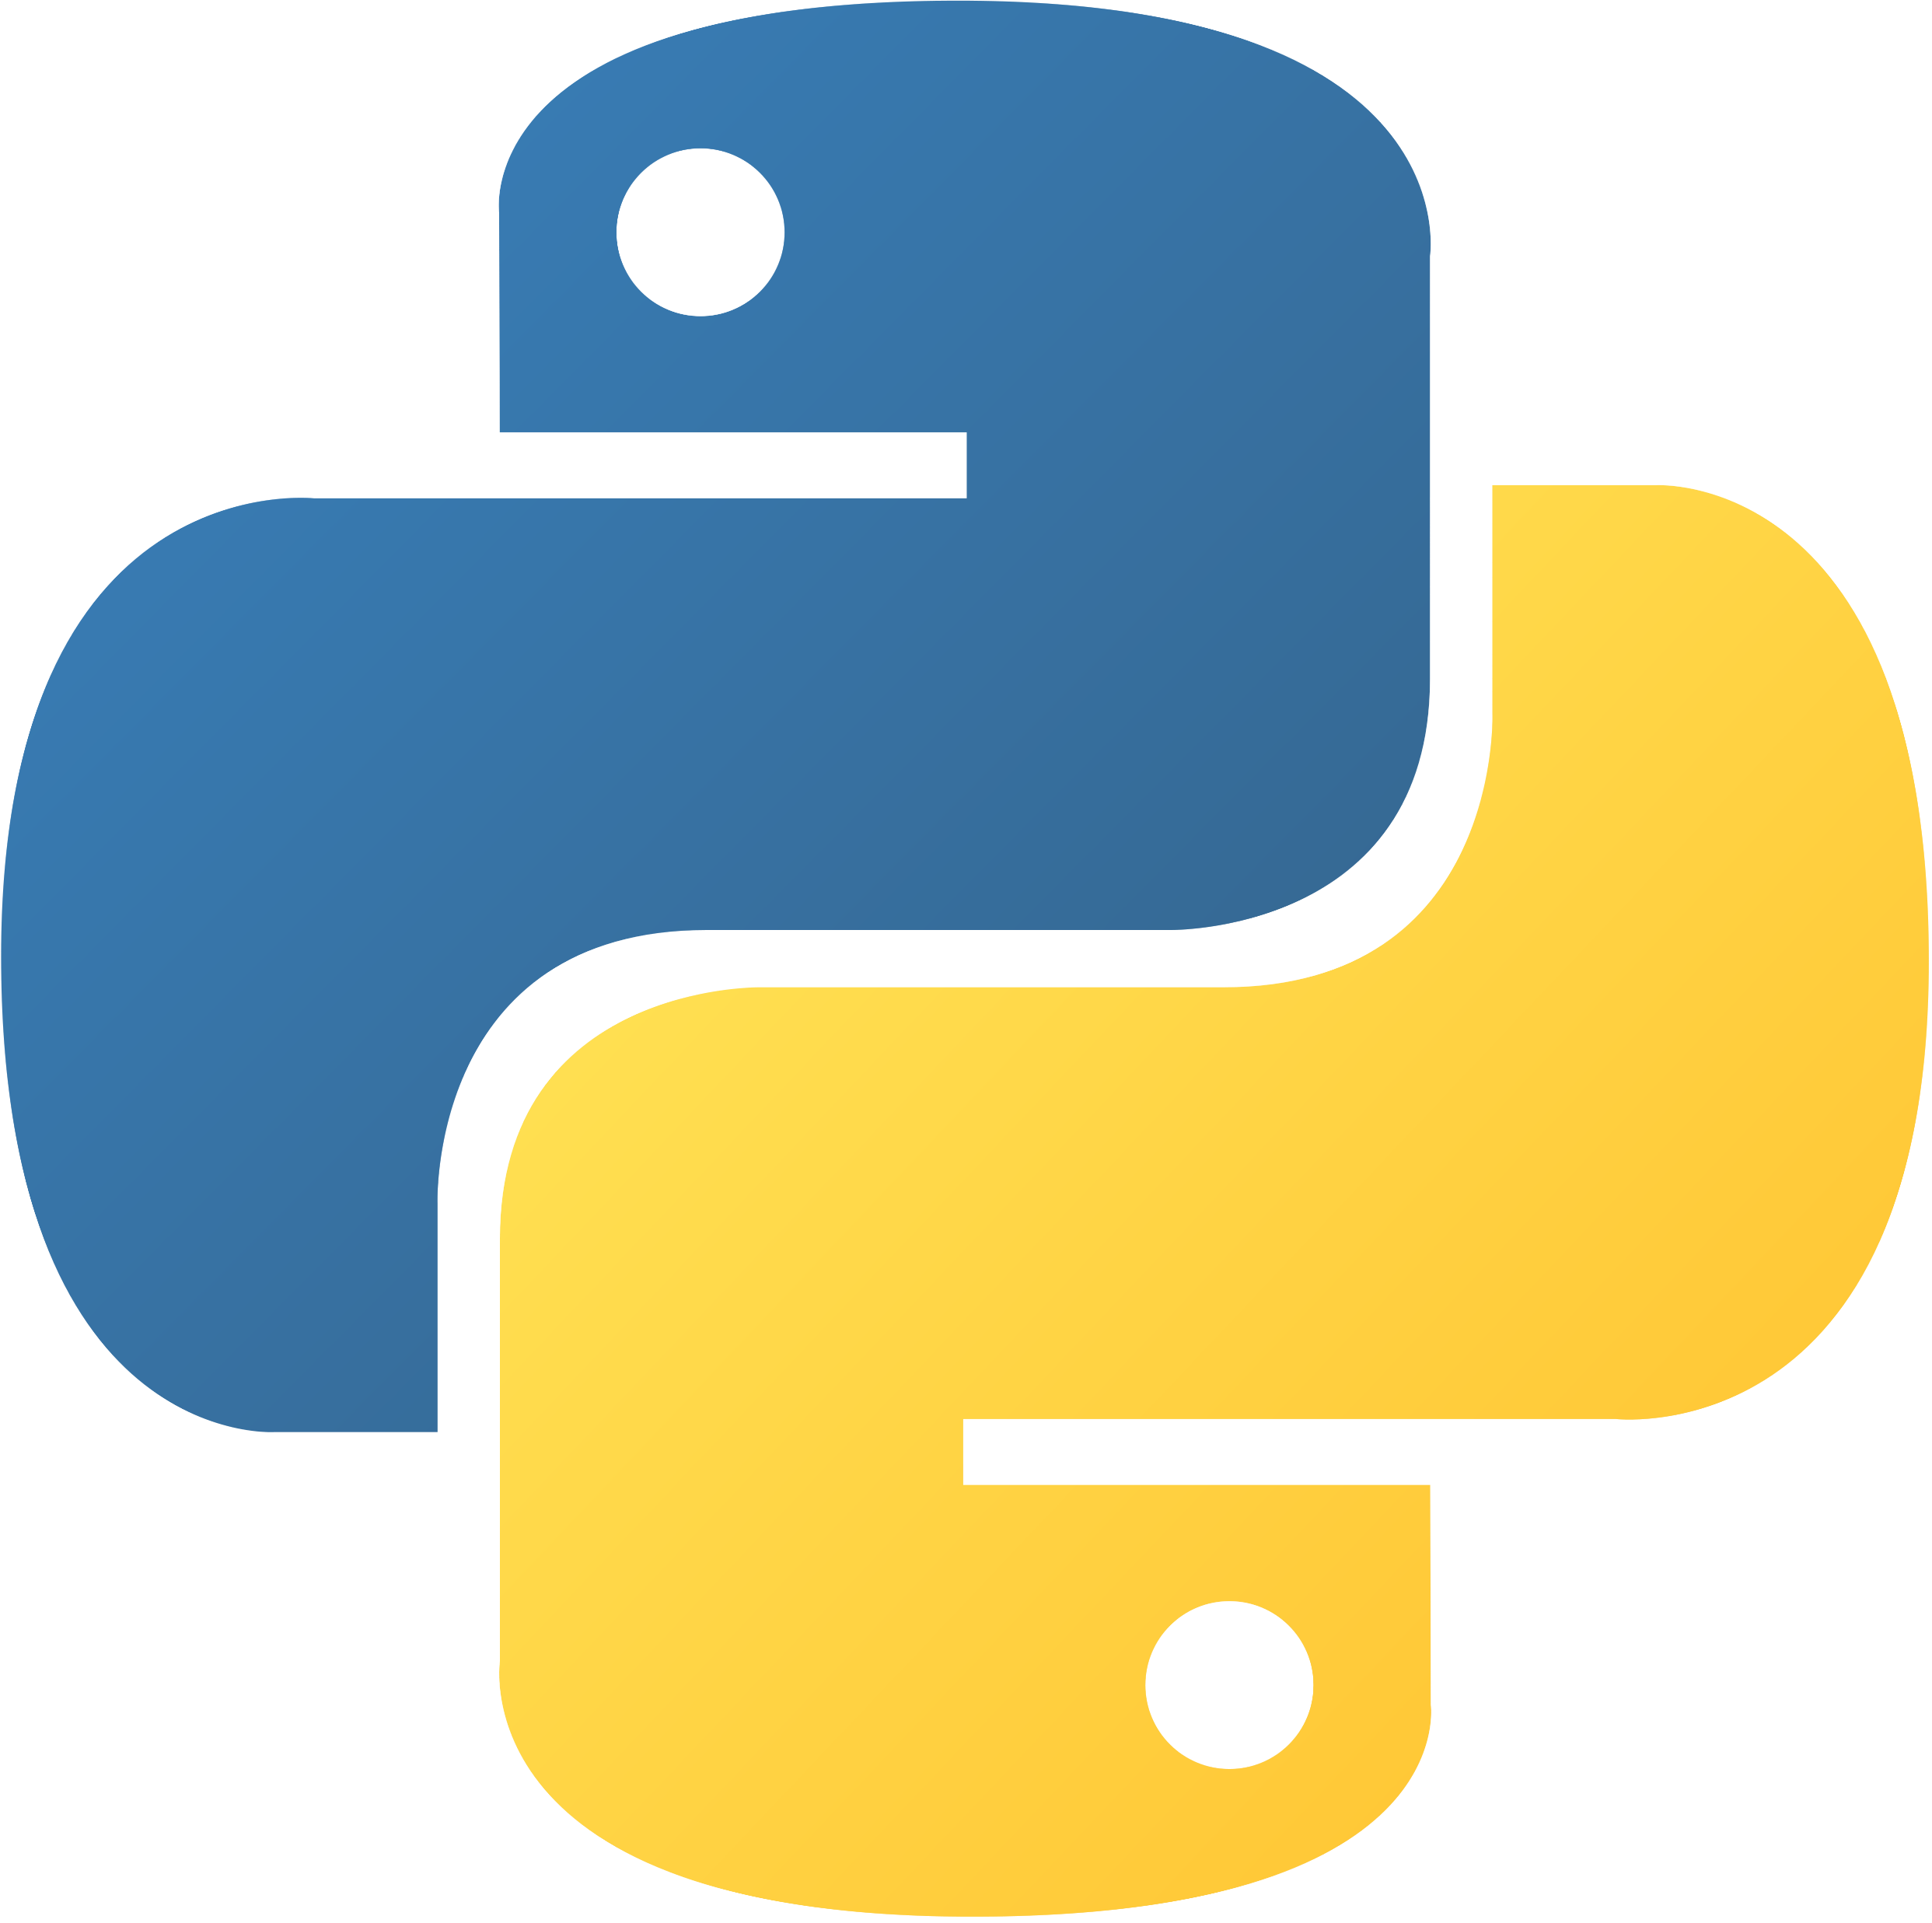
Python Class 12
Lists

Slide 2
Lists
A list is a group of things.
It is a type of variable, and it can have lots of information.
The index(添字) of lists starts at 0.

Slide 3

Python List
A list in Python needs square brackets [ ].
Each item in the list must be separated by a comma ,

Slide 4
List Structure
The list is like one big box
The list has many smaller boxes inside it.
These smaller boxes each hold different information.

Slide 5
List Structure, 2
my_list = [“a”,“b”,“c”,“d”,“e”,“f”,“g”]
“a”
“b”
“c”
“d”
“e”
“f”
“g”
my_list[0]
my_list[1]
my_list[2]
my_list[3]
my_list[4]
my_list[5]
my_list[6]

Slide 6
Making a list
Make a list that has the names of all your family members in it.
Access each member in the list and print it. We use square brackets [ ] to access an item.
Change the value of a member. Again, we use square brackets [ ].
family = [“Kathy”,”Doug”,”Michael”,”David”,”Mark”,”Sarah”,”Rachel”]
print(family[5])
What will this print?
family[0] = “Katherine”

Slide 7
List Practice
Use the in keyword for a list.
Use the len() function for a list.
Make a list of integers (maybe this is test scores, or number of students in a class, etc)
family = [“Kathy”,”Doug”,”Michael”,”David”,”Mark”,”Sarah”,”Rachel”]
if “Tom” in family:
print(“Hi Tom!”)
print(len(family))

Slide 8
List Practice, 2
Check the type of the list.
Check the type of the items in a list.
Check the last item using -1.
Use list.insert(index, item)
Use list.append(item)
Use list.remove(item)
Use list.pop(index)

Slide 9
Indentation
In Python, code with the same level of indentation is grouped together.
import datetime
user_name = “Mr. Hunter”
name = input(“What is your name?”)
if name == user_name:
print(“Hello, ” + user_name)
else:
print(“You are a new user”)
b_day_str = input(“What is your birthday? (YYYY-MM-DD)”)
b_day_str = b_day_str.split(“-”) #creates a list [YYYY,MM,DD]
if b_day_str[0] >= datetime.date.today().year: #causes error is user #name is Mr. Hunter
print(“you are too young, or you are from the future”)
import datetime
user_name = “Mr. Hunter”
name = input(“What is your name?”)
if name == user_name:
print(“Hello, ” + user_name)
else:
print(“You are a new user”)
b_day_str = input(“What is your birthday? (YYYY-MM-DD)”)
b_day_str = b_day_str.split(“-”) #creates a list [YYYY,MM,DD]
if b_day_str[0] >= datetime.date.today().year:
print(“you are too young, or you are from the future”)

Slide 10
Indentation, 2
Grouping code is a really important idea in programming.
Every modern programming language allows programmers to group code -> Java, Python, C#, C++, etc.

Slide 11
indentation, 3
import datetime
def GetBirthYear(b_day):
b_day = b_day.split(“-”) #creates a list [YYYY,MM,DD]
return int(b_day[0]) #change to an integer and give back
b_day_str = input(“What is your birthday? (YYYY-MM-DD)”)
year = GetBirthYear(b_day_str)
if year <= 1996 and year > 1980:
print(“You are a Mi”)
print(“You are a Mil”)
print(“You are a Millennial”)
elif year <= 1980 and year > 1965:
print(“You are a Gen Xer”)
elif year > 1996:
print(“You are a Zoomer”)
print(“You are a Zoomer”)

Slide 12
List Practice, 3
Go back to the Vending Machine Project.
Replace the product variables with one list → product_list = [“Black Coffee”, other products]
Fix the rest of the code so that the program runs correctly.

Slide 13
List Practice, 3
Make a list of product prices. → product_price_list = [130, 160, other products’ prices]
Make a list of product amounts. → product_amount_list = [50, 20, other products’ amounts]
Fix the rest of the code so that the program runs correctly.

Slide 14
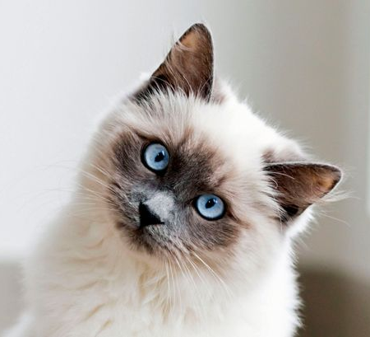
EVALUATE THE CHANGES IN VENDING MACHINE
Do you think using lists is better or worse than before?
Why?

Slide 15
Common Errors

Slide 16
spelling
Name error
Capitalization
n = “Tom”
print(na)
if x.isupper():
print(“It’s upper! Yay!”)
import datetime
date = datetime.date(2022,6,21)
print(Date.weekday())

Slide 17
Indentation
Your indentation doesn’t match the rest of the code.
Your indentation doesn’t match what you want to do.
import datetime
date = datetime.date(2022,6,21)
print(Date.weekday())
import datetime
date = datetime.date(2022,6,21)
if Date.weekday() == 1:
print(“It’s Tuesday!”)
print(“It’s a weekday”)

Slide 18
Numbers
Zero division error
you are trying to divide a number by 0. Check where it happens.
Index error
you tried to use an index that is larger (smaller) than the list
b = 0
a = 7 / b
li = [“Arthur”, “Lancelot”, “Gawain”, “Kay” ]
print(li[4])
print(li[-5])

Slide 19
Type/Assignment
Type error
Using assignment instead of equality
= versus ==
import datetime
s = “Tuesday”
d = datetime.date(2022,6,22)
x = d + s
li = [“Arthur”, “Lancelot”, “Gawain”, “Kay” ]
li2 = [“Arthur”, “Lancelot”, “Gawain”, “Kay” ]
li = li2
print(li == li2)

Slide 20
Function results
Remember, some functions give a return value, but some give None.
You need to know which is which.
l = [“Hayao Miyazaki”, “Kentarou Miura”, “Takehiko Inoue”]
l = l.append(“Kohei Horikoshi”)
append doesn’t have a return value, so now l is lost!!!

Slide 21
Function Arguments
Python always expects a function’s arguments to be in the same order.
name = “Kentarou Miura”
name = name.replace(“Taro”, “Kentarou”)
this will not give an error, but the replace function expects the part we want to find first, then what we want to change it to

Slide 22
global vs. local / attribute
Unbound local error
You tried to assign a value to a global variable inside a function
Attribute error
you tried to access a function or piece of information that doesn’t exist
x = 5
def sq():
x = x**2
li = [“Arthur”, “Lancelot”, “Gawain”, “Kay” ]
li.isupper() #only exists for str variables
li.ascii_uppercase # only exists for the special string library, which you need to import

Slide 23
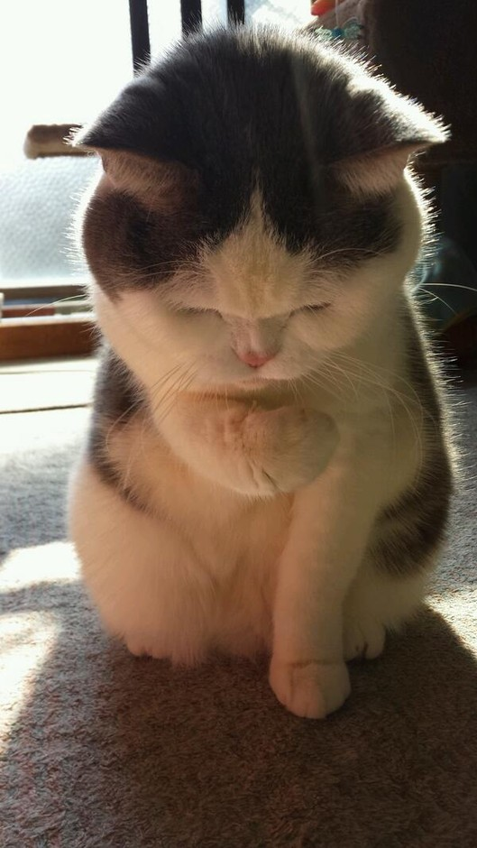
And many many many many more
As you get more experience as a programmer, you will encounter lots of other bugs and errors while you program.
Also, you will become faster at finding them.
You will never write perfect code, but that is OK!

Slide 24
Loops and looping

Slide 25
Repitition
https://youtu.be/KbiSxunJatM?t=34

Slide 26
Groundhog day
Groundhog Day (Clip 3) - Repeated Dying Sequence - YouTube

Slide 27
Loops
A loop is a way to repeat a statement or command.

Slide 28
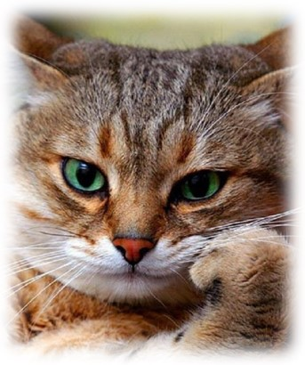
Loops
What are loops good for?

Slide 29
Loops, Continued
In Python, the most basic kind of loop is a for loop.
A for loop has this syntax:
in keyword
colon
for keyword
The statement you want to repeat. Indented 4 spaces or 1 tab.

Slide 30
Loops and lists
days = [“Mon”, “Tues”, “Wed” , “Thurs” , “Fri”, “Sat”, “Sun”]
for x in days:
print(x)

Slide 31
Spaces versus tabs
https://www.youtube.com/watch?v=SsoOG6ZeyUI

Slide 32
Ways to control a for-loop
Use range(a)
Use range(a,b)
Use in + a list
Use len(a)

Slide 33
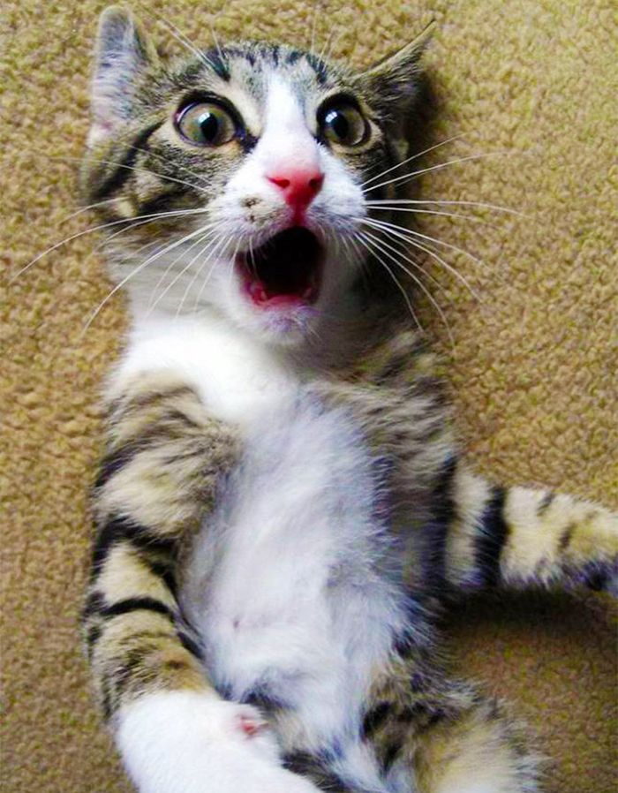
Loops, if and scope
Loops and if work very differently than functions.
def my_func(a):
x = 5 * (a*a) + 11
my_func(10)
print(x) # this gives an error
for x in range(10):
a = 2 * x
print(a)
print(a) #this is fine!
print(x) #this is fine, too!
n = "y"
if n == "w":
b = "y2"
else:
c = "x"
print(b) #this gives an error
print(c) #this is fine!

Slide 34
Loops and scope
If you need to keep a value while running a for-loop, you should make the variable before it.
for x in range(10):
a = 0
a = a + x
print(a)
a is set to 0 each time you run through the loop, so the last value is 9…
a = 0
for x in range(10):
a = a + x
print(a)
a is set to 0 outside the loop, so previous value gets added to it each time

Slide 35
Loop Exercises
Create a loop that counts from 0 to 100
Create a loop that multiplies the numbers from 1-20.
Create a loop that adds random numbers to a list.
Use a loop to find the largest and smallest numbers, and the average.

Slide 36
Ways to control action inside a loop
You can use if-statements and break or continue to control action
li = [2,4,6,8,10,11,14,16,18]
for x in li:
if x % 2 != 0:
break
print(x)
li = [1,4,9,16,25,0,36,49,64]
for x in li:
if x == 0:
continue
else:
print((li.index(x) +1) / x)
we want to stop the loop completely if we have an odd number
we just want to skip the number to avoid dividing by 0

